Slide 1

Peer to peer energy trading using block chain
Team members:-
Poojitha devineni
Ramu jahna bindu
Jovika n.B

Slide 2
What is block chain ?
Blockchain is a decentralized, distributed ledger technology that securely records transactions across multiple computers. It consists of a chain of blocks, where each block contains a list of transactions, a timestamp, and a cryptographic hash of the previous block, making it tamper-proof and immutable.
What is peer to peer energy trading ?
Peer-to-peer (P2P) energy trading is a decentralized energy market where individuals (prosumers) can buy and sell excess electricity directly with each other, without relying on traditional utility companies. This trading system is typically powered by blockchain technology, ensuring secure, transparent, and automated transactions.

Slide 3
Problem statement :-
Centralized Control: Energy distribution is dominated by large utility companies.
Inefficiency & High Costs: High transaction costs and delays in settlements.
Energy Wastage: Excess energy from renewable sources often goes unused.
Lack of Transparency: Energy prices are set by centralized authorities without user control.
No Direct Trading Mechanism: Consumers cannot directly buy energy from nearby prosumers.
Blockchain-Based Solution
Decentralization: Removes intermediaries, allowing direct transactions between users.
Dynamic Pricing Model: Uses real-time machine learning to predict energy demand & adjust pricing.
Secure Transactions: Uses blockchain for immutable and tamper-proof records.

Slide 4
Storing Data in Blockchain
1. Transaction Initiation (Energy Buying/Selling)
2. Transaction Broadcast (Sent to Blockchain Nodes)
3. Transaction Validation (Using PoW / PoS Consensus)
6. Block Linking (Connected to Previous Block via Hash)
5. Block Hashing
(SHA-256 / Other Algorithm)
4. Block Formation (Valid Transactions Grouped into a New Block)
7. Block Addition (New Block Added to Chain and Distributed to Nodes)
8. Blockchain Update
(All Nodes Synchronize)

Slide 5
Deployment of smart contract
We have deployed the smart contract in 2 ways
deployment
Using python
Using remix.ide
Ganache testnet
Meta mask

Slide 6
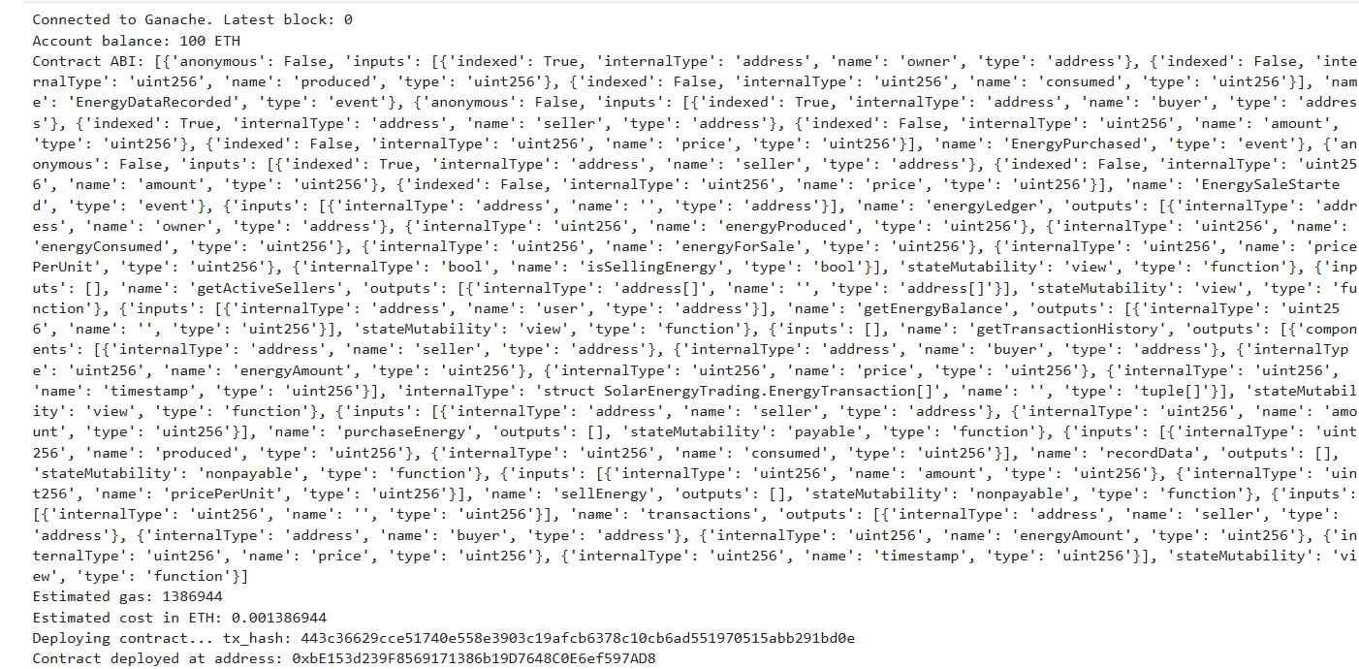
Deployment using python
Start Ganache
Connect to Ganache
Load & Compile the contract
Sign & Deploy Transaction
Interact with Contract

Slide 7
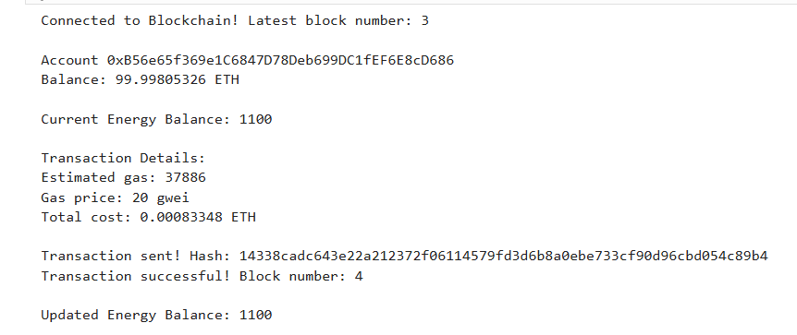
After deploying the smart contract using ganache interaction to python

Slide 8
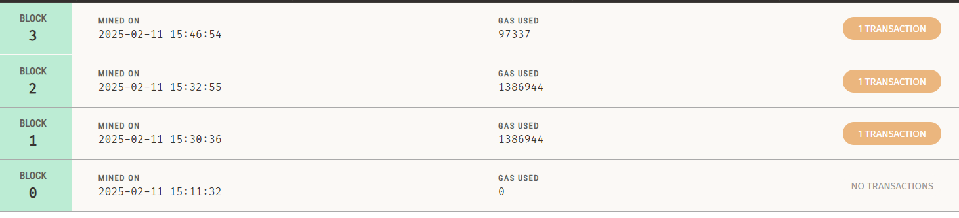
After deployment the transaction data is stored in ganache
After deploying a smart contract or interacting, a transaction is created and sent to the network.
This transaction needs to be validated and confirmed by miners
Once included in a block, the transaction is considered mined, meaning it has been successfully recorded on the blockchain.

Slide 9
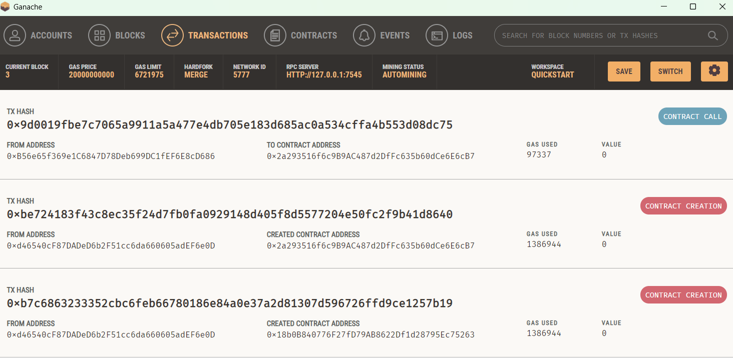
Transaction details
Every transaction (contract deployment, function call, transfer, etc.) has a unique identifier called a transaction hash.
This hash is a 64-character hexadecimal string generated by cryptographic functions.
It allows you to track the transaction on a blockchain explorer (e.g., Etherscan for Ethereum).

Slide 10
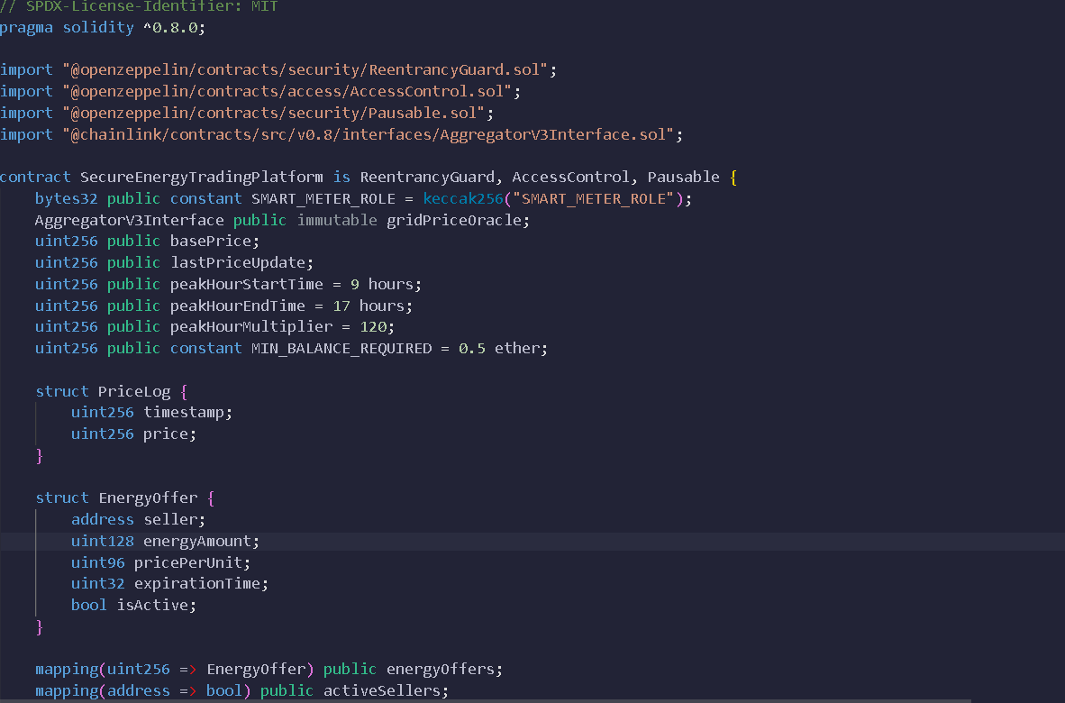
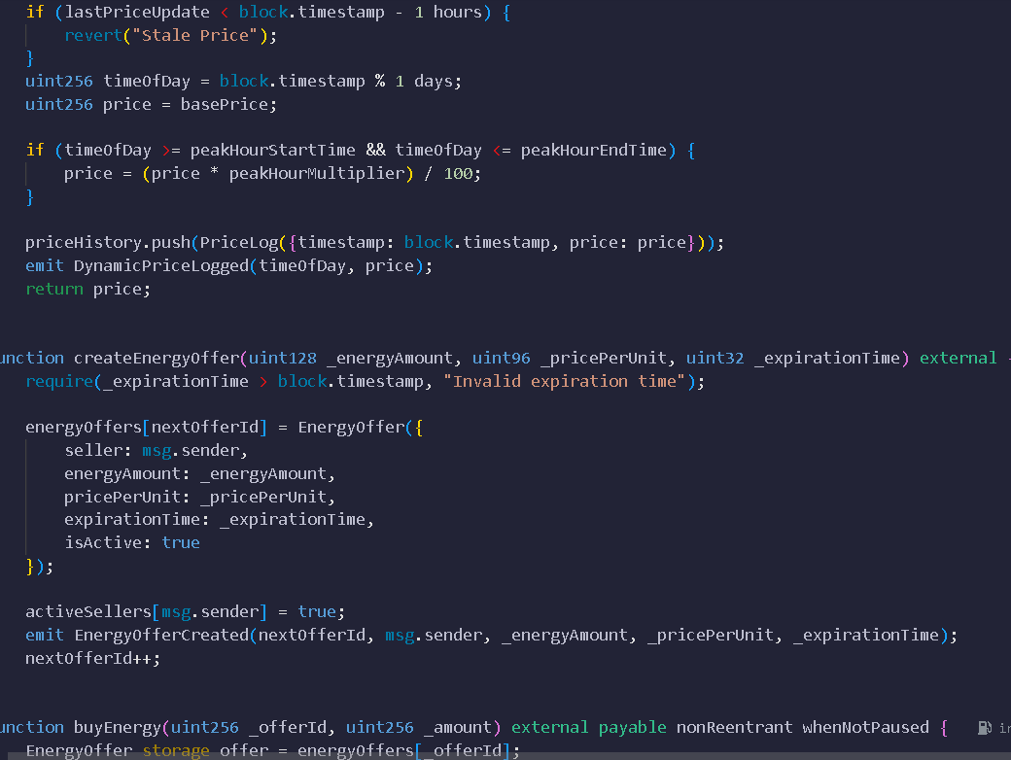
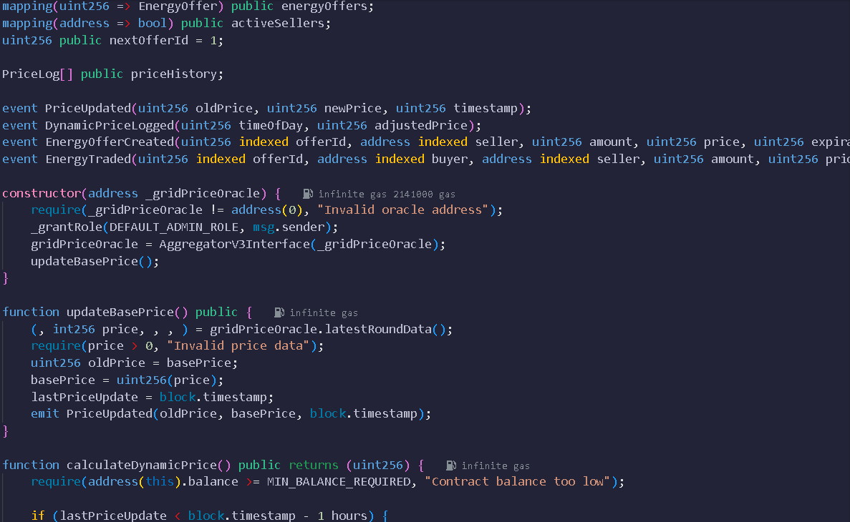
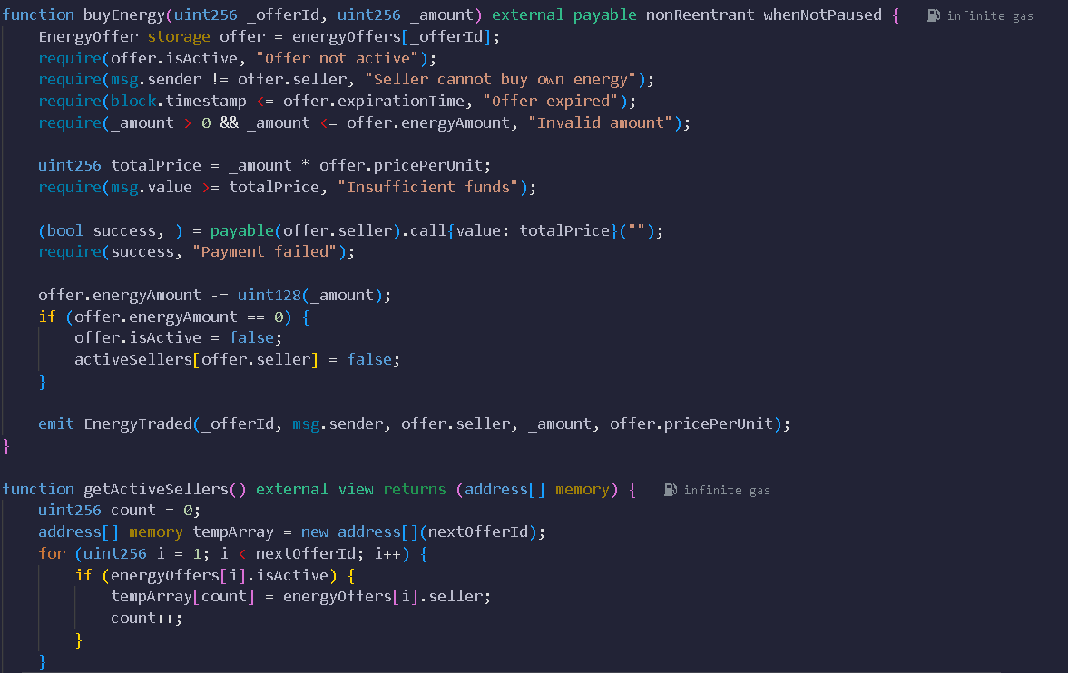
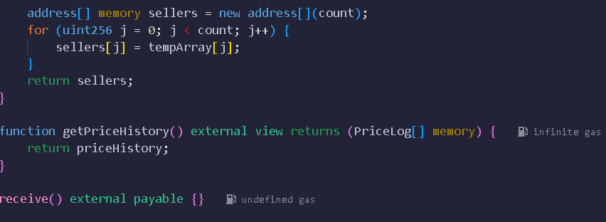
Deployment using remix.ide
Write a smart contract
1
3
Compile in Remix IDE(Check for Errors)
Deploy on Sepolia(MetaMask / Infura)
2
4
5
Interact via Web3.py(Python & Web3.py)

Slide 11
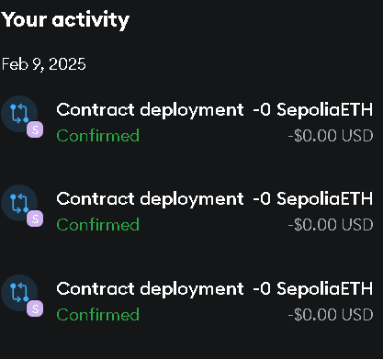
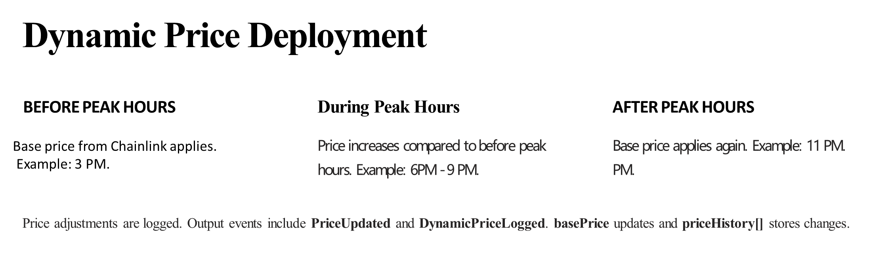
TRANSACTION
1.AFTER DEPLOYMENT THE TRANSACTIONS ARE STORED IN METAMAMASK.
2. WE HAVE DEPLOYED THE CONTRACT THREE TIMES ,THAT IS DURING PEAK HOURS,BEFORE PEAK HOURS AND AFTER PEAK HOURS.
3.TO DEPLOY THE CONTRACT WE HAVE TO ENTER THE CHAINLINK'S ORACLE ADDRESS THAT IS SEPOLIA'S DEFAULT ADDRESS WHICH UPDATES BASED ON REAL TIME.

Slide 12
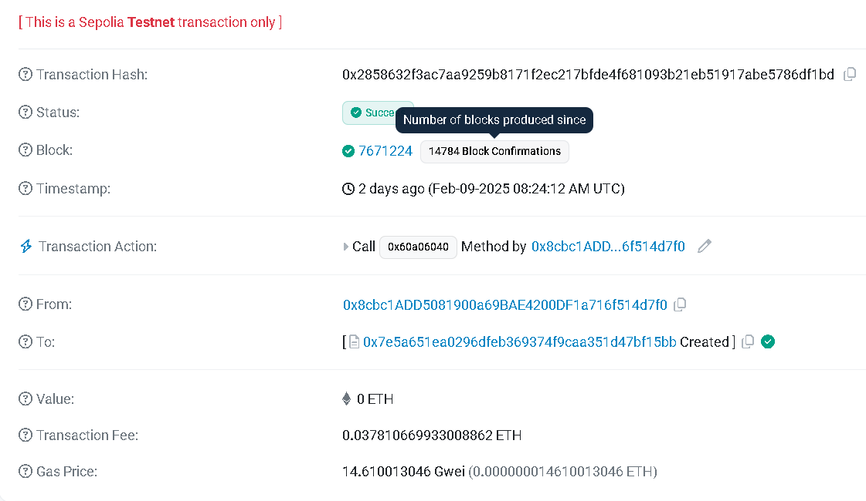
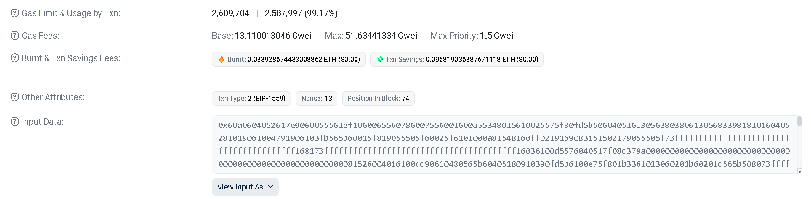
RESULT
1. BEFORE PEAK HOURS

Slide 13
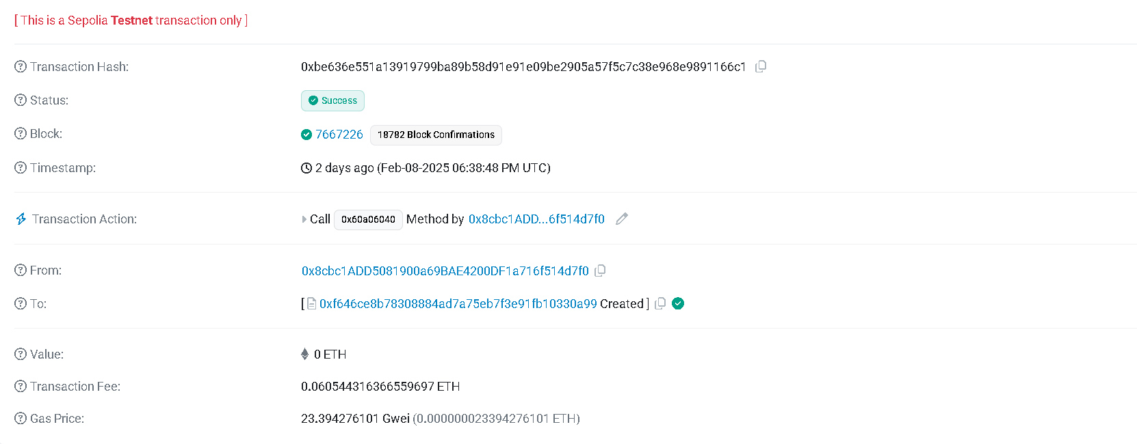
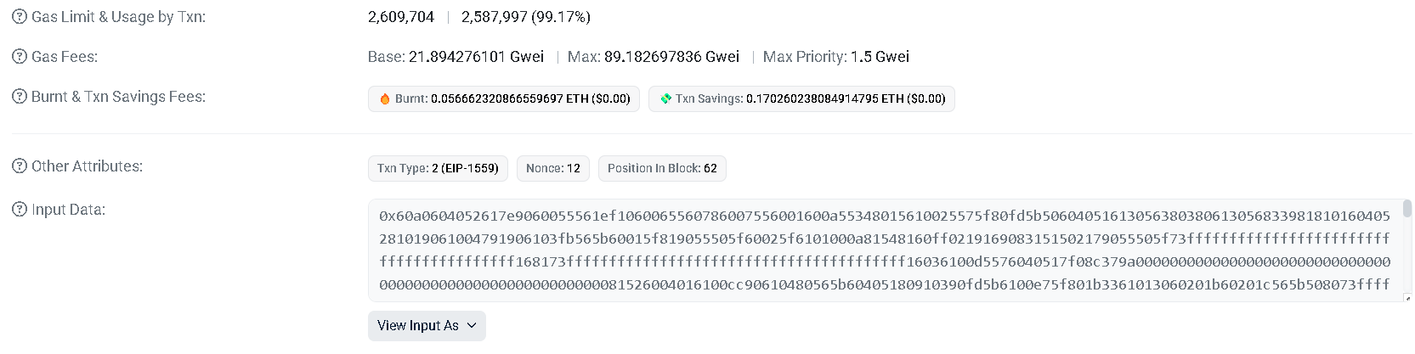
2 DURING PEAK HOURS

Slide 14
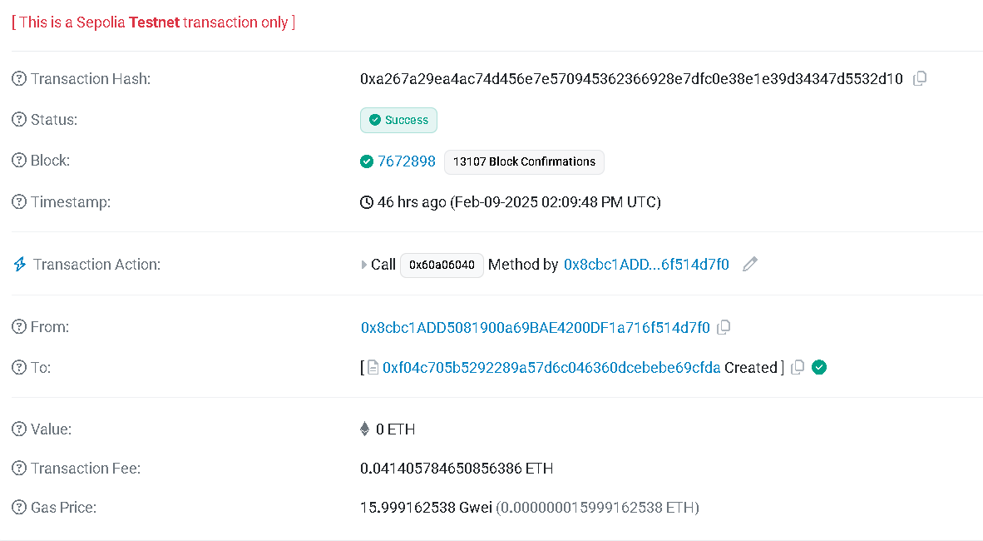
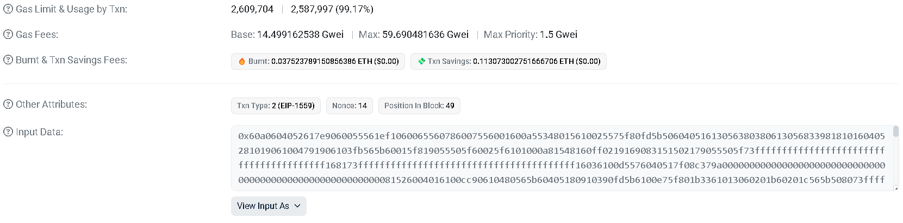
3. AFTER PEAK HOURS
THESE ARE THE RESPRICE AND THE TRANSACTION FEE AND THE TIME THE
THE TIME IS IN UTC(Coordinated Universal Time).
THE GAS FEES IN GIVEN IN GWEI(one gwei is 0.000000001 ETH).

Slide 15
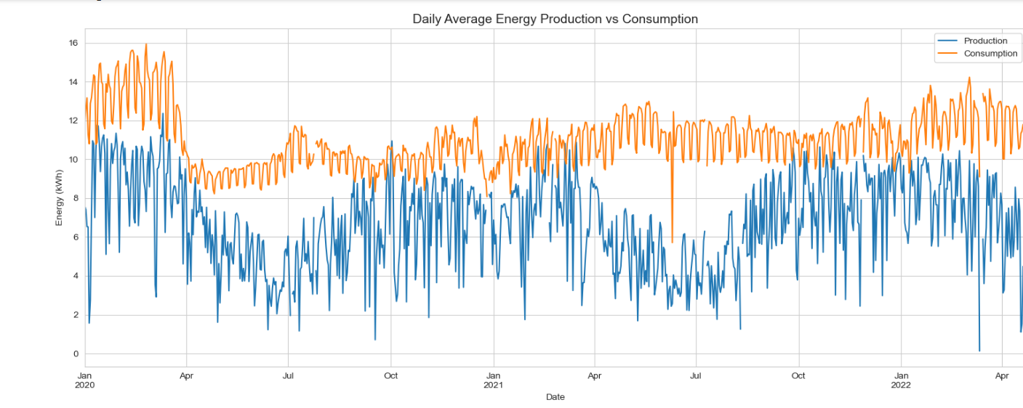
Loading and analysing the data

Slide 16
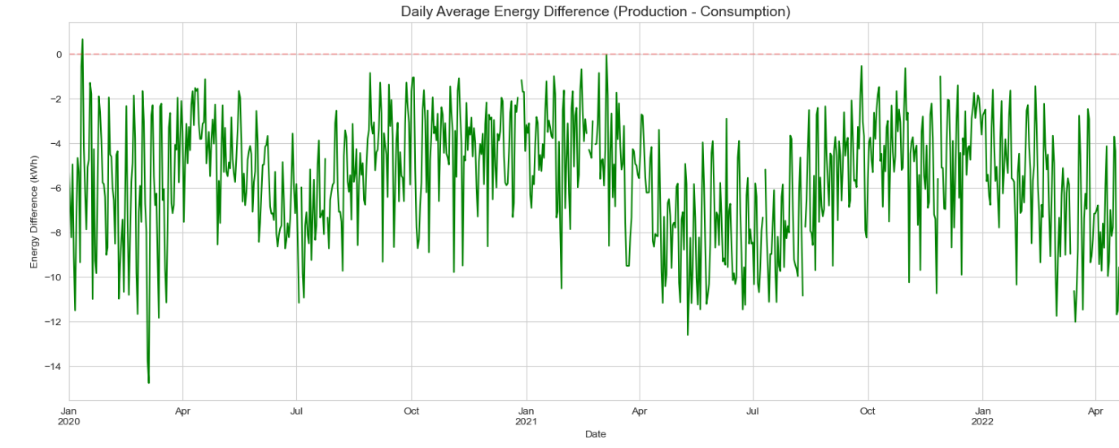
Difference between energy production and consumption

Slide 17
Machine learning model
We are using machine learning model to predict the energy production
Why we are predicting the energy production?
Based on the above analysis energy consumption is more than production. To predict that we have to use ml
If production is lower than demand, there may be energy shortages.
If production is higher than demand, excess energy might go wasted.
Prediction helps maintain a stable and efficient energy marketplace.

Slide 18
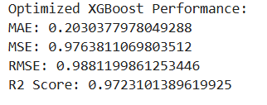
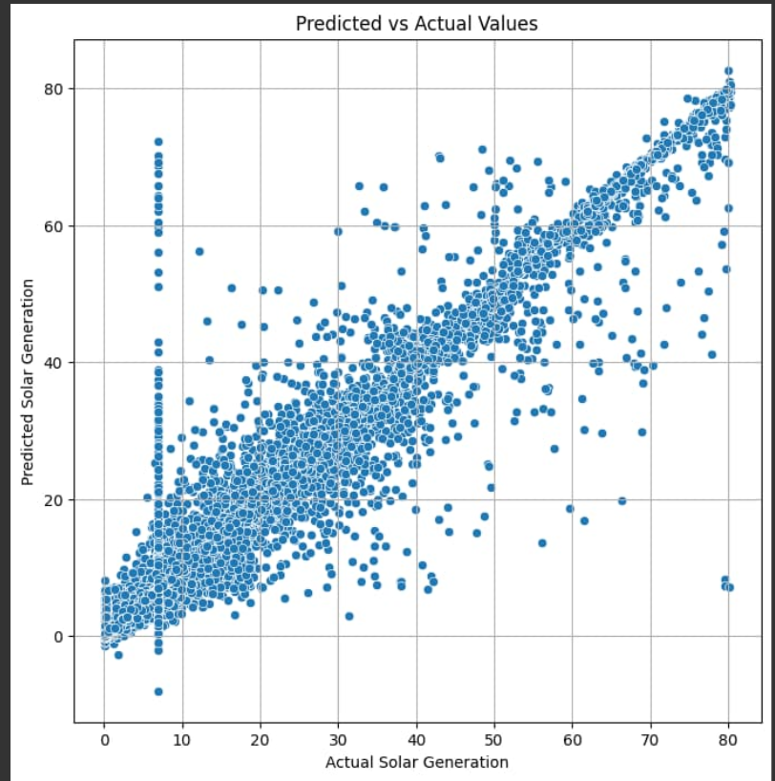
Uses Multi-Layer Feedforward (MLFF) Neural Network & XGBoost with Bayesian Optimization.
Results for energy prediction model
Uses Multi-Layer Feedforward (MLFF) Neural Network & XGBoost with Bayesian Optimization.

Slide 19
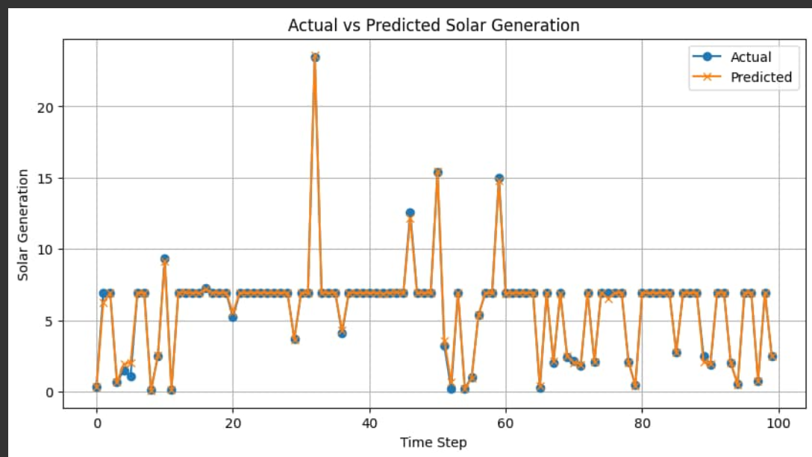
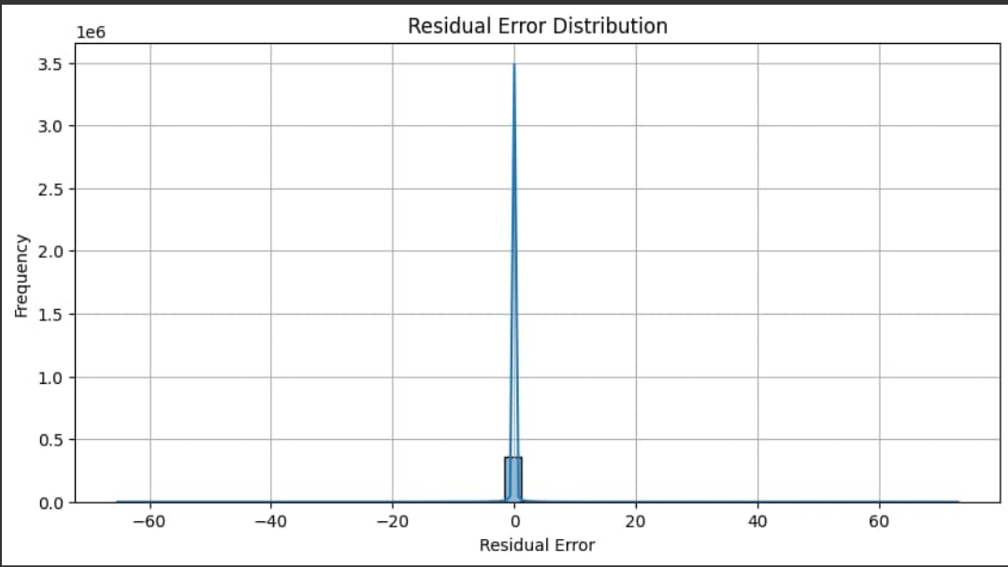
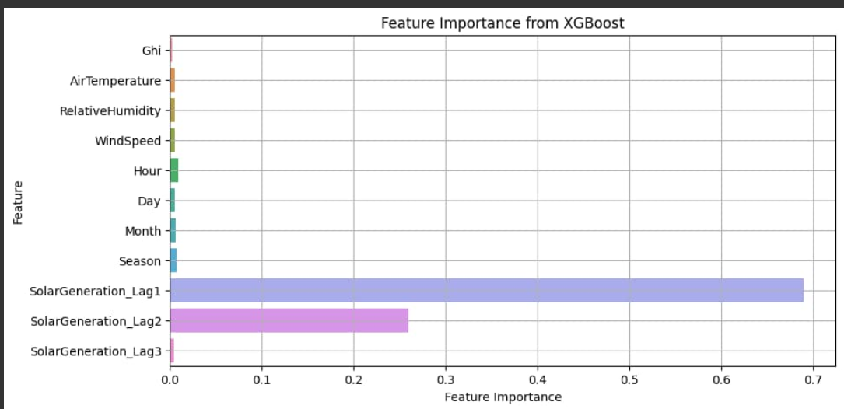
Preprocesses data with feature engineering, lag features, and scaling.
Fetches real-time weather & energy data for accurate predictions.

Slide 20
Connecting ml to smart contract
Flask API Connects the ML model with the smart contract.
Uses Web3.py to interact with blockchain (Ganache, Infura, or other RPC provider).
Updates the smart contract dynamically with predicted energy values.

Slide 21
Energy prediction
Block diagram for whole block chain
Energy data
Loading and analysing
Machine learning
Block chain
Smart contract
Dynamic pricing

Slide 22
Completed steps:-
Deployment of contract using python and interation
Integration of dynamic pricing to smart contract
Deployment of smart contract using remix. ide
Ml for predictiong the energy generation
Incomplete steps:-
Integration of ml to smart contract

Slide 23
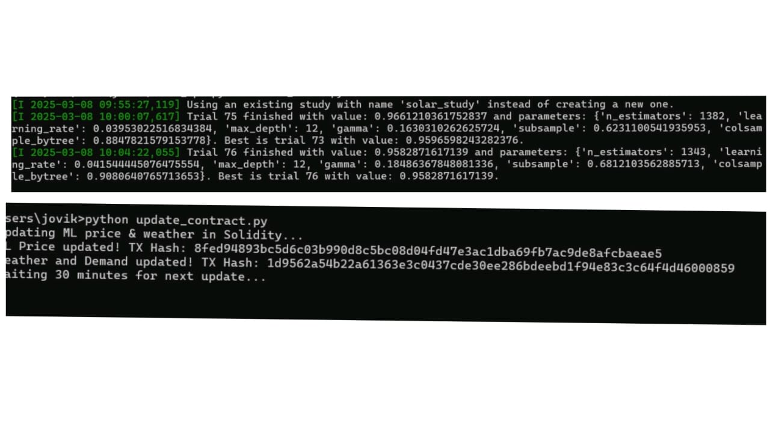
Process of Deploying the smart contract
1.Smart Contract Deployment
Use MetaMask & Remix IDE to deploy the contract
Contract handles energy trading, pricing, and transaction storage
2.Model Training
Run model_training.py to train the ML model
Predict energy generation and demand
Store model outputs in SQL database
3.API Server Execution
Start app.py to facilitate communication
Fetch model predictions from the SQL database
Manage user requests for energy trading
4.Blockchain Interaction
Run update_contract.py to send cryptographic hash details to the smart contract
Smart contract updates blockchain with secured ML predictions.
Ensures tamper-proof energy trading records

Slide 24
Data Collection & Preprocessing
🔹 Datasets Used:
Solar Energy Generation (Historical energy data)Solar Irradiance (Sunlight intensity data)Weather Data (Temperature, humidity, wind speed)Site Details (Solar panel locations & capacities)
🔹 Processing Steps:
Convert timestamps to usable formatsMerge datasets based on Timestamp and CampusKeyHandle missing values in weather and solar generation dataGenerate time-based features (Hour, Day, Month, Season)Create lag features (Previous energy values for better prediction)
Machine Learning Model for Energy Prediction
🔹 Model Used: XGBoost Regressor
🔹 Optimization: Optuna Hyperparameter Tuning
🔹 Training Process:Train-test split (80%-20%)Standardization (Scaling) of input featuresBayesian Optimization using OptunaEvaluate with MSE, MAE, RMSE, and R² ScoreSave the trained model (xgboost_model.pkl) and scaler (scaler.pkl)
🔹 Prediction Process:
Fetch real-time weather data using OpenWeather APIExtract relevant features (Air Temperature, Wind Speed, etc.)Apply scaling using the saved scalerPredict solar energy generation in kWh

Slide 25
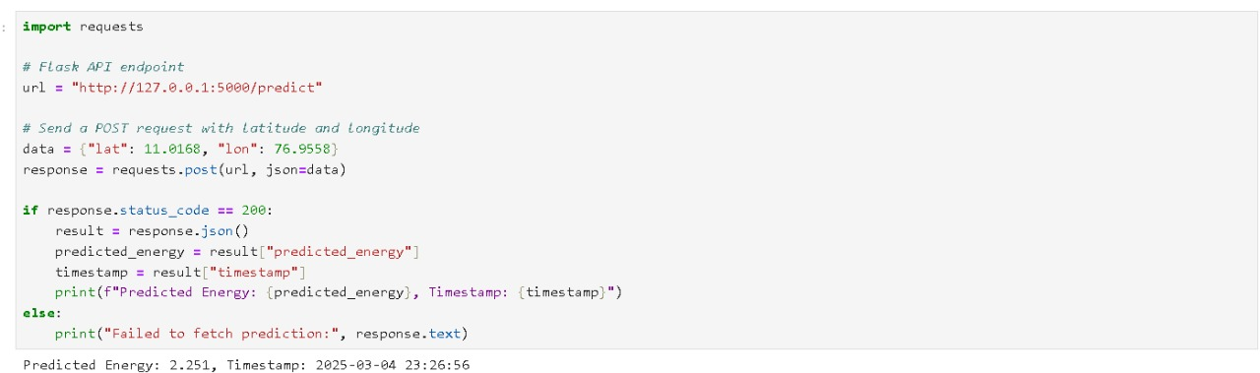
Backend API Development (Flask + FastAPI)
🔹 Flask API (app.py) for ML Predictions/predict → Fetches real-time weather data, predicts solar energy output/predictions → Returns last 5 predicted energy values
🔹 FastAPI for Smart Contract Integration/get_live_energy_price → Fetches current dynamic energy price from blockchain/get_active_sellers → Returns available sellers/execute_trade → Executes peer-to-peer energy trade transaction
Automated System for Real-Time Updates
🔹 Tasks Every 30 Minutes:
✅ Fetch latest weather data & ML predictions
✅ Update Solidity smart contract with ML-predicted price
✅ Store results in SQLite (solar_predictions.db)

Slide 26
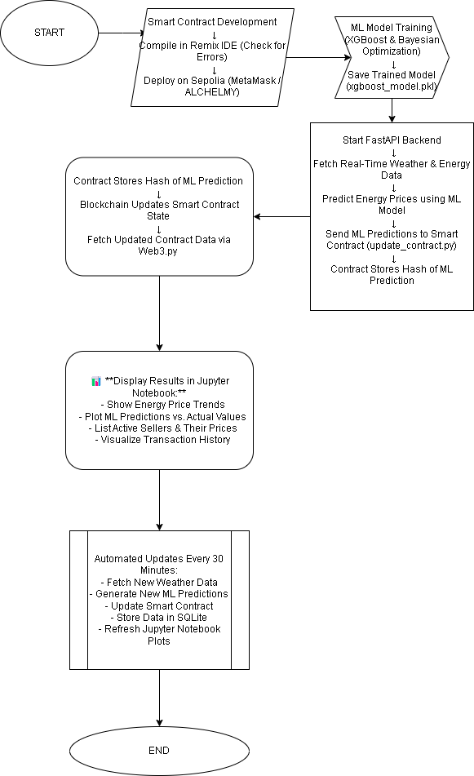

Slide 27
